Slide 1
Immersed Boundary using Lagrange multiplier for heat equation problems
Par : Lucka Barbeau

Slide 2

What is an Immersed Boundary
An immersed boundary is the imposition of boundary condition on a curve, surface or even volume that is inside the domain of calculation. We denote $Γ$ as the subdomain or the immersed boundary and $Ω$ the computational domain. We then have $ΓεΩ$.
  This is useful to represent particles in fluids or any moving objects in fluids or imposing boundary condition on complex geometry and in many other applications.
The mesh of the Immersed boundary domain $Γ$ doesn’t have to be align with the mesh of the computational domain $Ω$.
The main advantage is that we can modified the boundary condition geometry and position without having to generate a complete new mesh for $Ω.$

Slide 3
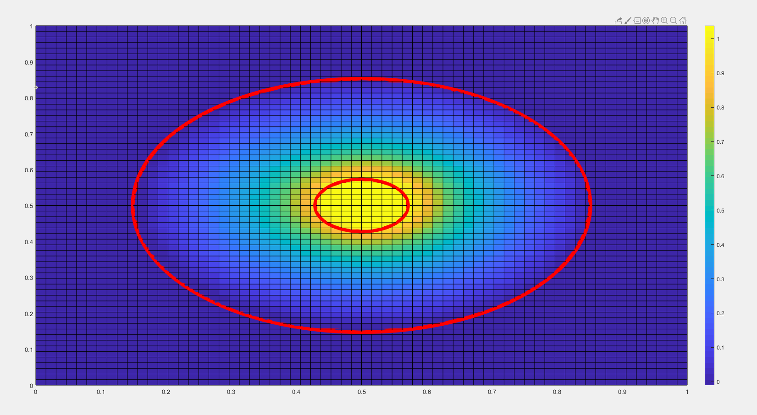
Immersed Boundary Visualisation
Example of the imposition of immersed boundary ( Red line) on the a computational domain.
The case that is going to be study is the temperature between 2 circles in a square domain

Slide 4
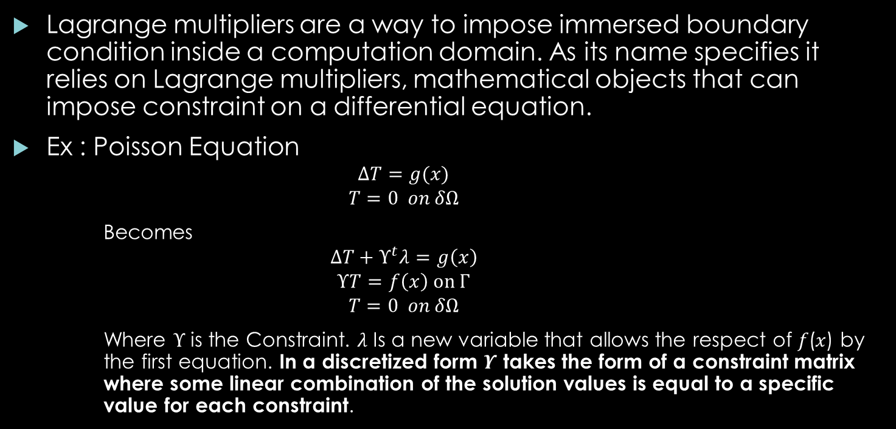
Generality Using Lagrange Multiplier for Immersed Boundary
Lagrange multipliers are a way to impose immersed boundary condition inside a computation domain. As its name specifies it relies on Lagrange multipliers, mathematical objects that can impose constraint on a differential equation.
Ex : Poisson Equation
    $$ΔT=g(x)$$
    $$T=0 on δΩ$$
    Becomes
    $$ΔT+Υ^{t}λ=g\left(x\right)$$
    $$ΥT=f\left(x\right) on Γ$$
    $$T=0 on δΩ$$
    Where $Υ$is the Constraint. 𝜆 Is a new variable that allows the respect of 𝑓(𝑥) by the first equation. In a discretized form $Υ$ takes the form of a constraint matrix where some linear combination of the solution values is equal to a specific value for each constraint.

Slide 5

Generality using Lagrange Multiplier for Immersed Boundary
The discretized system will then look something like:
$\left[\begin{matrix}A & Υ^{t} \\ Υ & 0\end{matrix}\right]\left[\begin{aligned}T \\ λ\end{aligned}\right]$= $\left[\begin{aligned}g(x) \\ f(x) \end{aligned}\right]$
Where 𝐴 is the discretized form of the PDE we are trying to solve. In the case of the Poisson equation, A would represent the second derivative stencil of T.
In the next part of this presentation, we will look at how the different methods to define $Υ$ and the results it gives us.

Slide 6
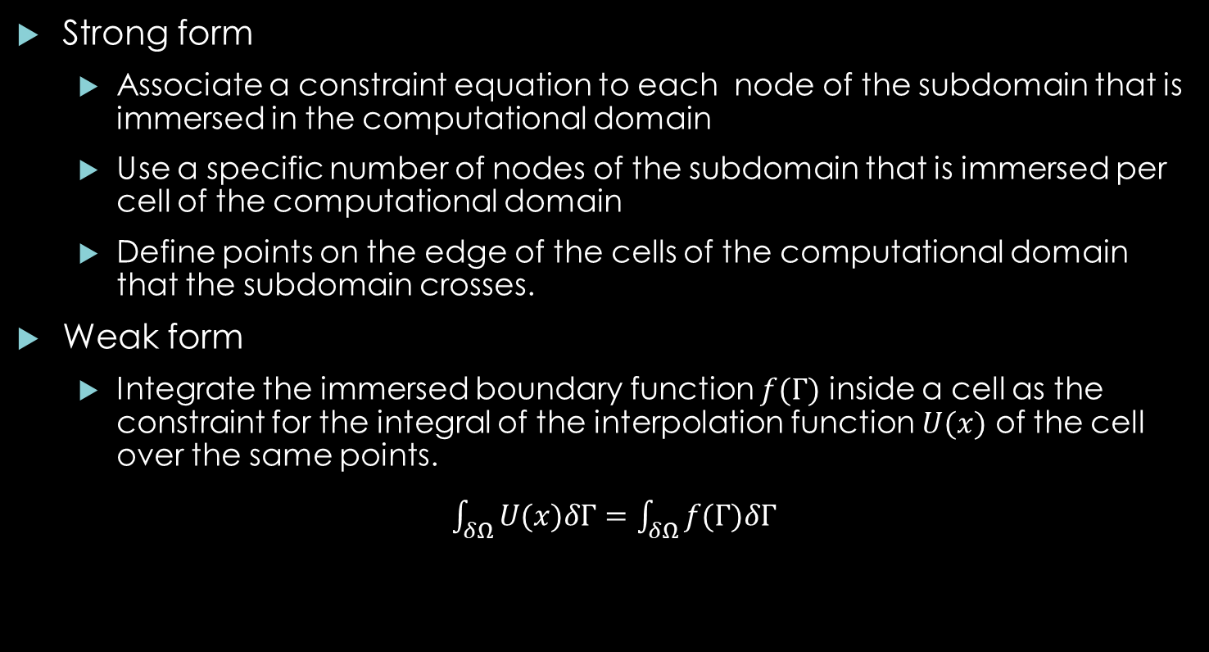
Implementation Methods of Lagrange Multiplier Immersed Boundary
Strong form
  Associate a constraint equation to each node of the subdomain that is immersed in the computational domain
  Use a specific number of nodes of the subdomain that is immersed per cell of the computational domain
  Define points on the edge of the cells of the computational domain that the subdomain crosses.
Weak form
  Integrate the immersed boundary function $f(Γ)$ inside a cell as the constraint for the integral of the interpolation function $U(x)$ of the cell over the same points.
  $\int_{δΩ}{U(x)δΓ}=\int_{δΩ}{f(Γ)δΓ}$

Slide 7
Strong Form: Constraint for Each Nodes of the Subdomain
This method consists in creating a constraint equation for each of the points of the subdomain in a cell. This method is not stable as it will results in a singular matrix if there are more subdomain points then nodes on the mesh. Because of that, these methods will not be studied further.
Cell 1
Here we have 10 points of the subdomain for 6 computational domain nodes. This would result in a system of equations with 10 equations and 6 unknowns
Cell 2

Slide 8
Strong Form: Specific Number of Nodes per Cell
The idea is to limit the number of points inside a specific cell to a specific number to prevent over constraining nodes of that cell.
  Logic: select the first point of the subdomain that is defined in a given cell. Define the interpolation of the cell at that point equal to the value of the immersed boundary value at that point.
First point inside the cell 1
Only those two points are used to define the constraints.
Cell 1
First point inside the cell 2
Cell 2

Slide 9
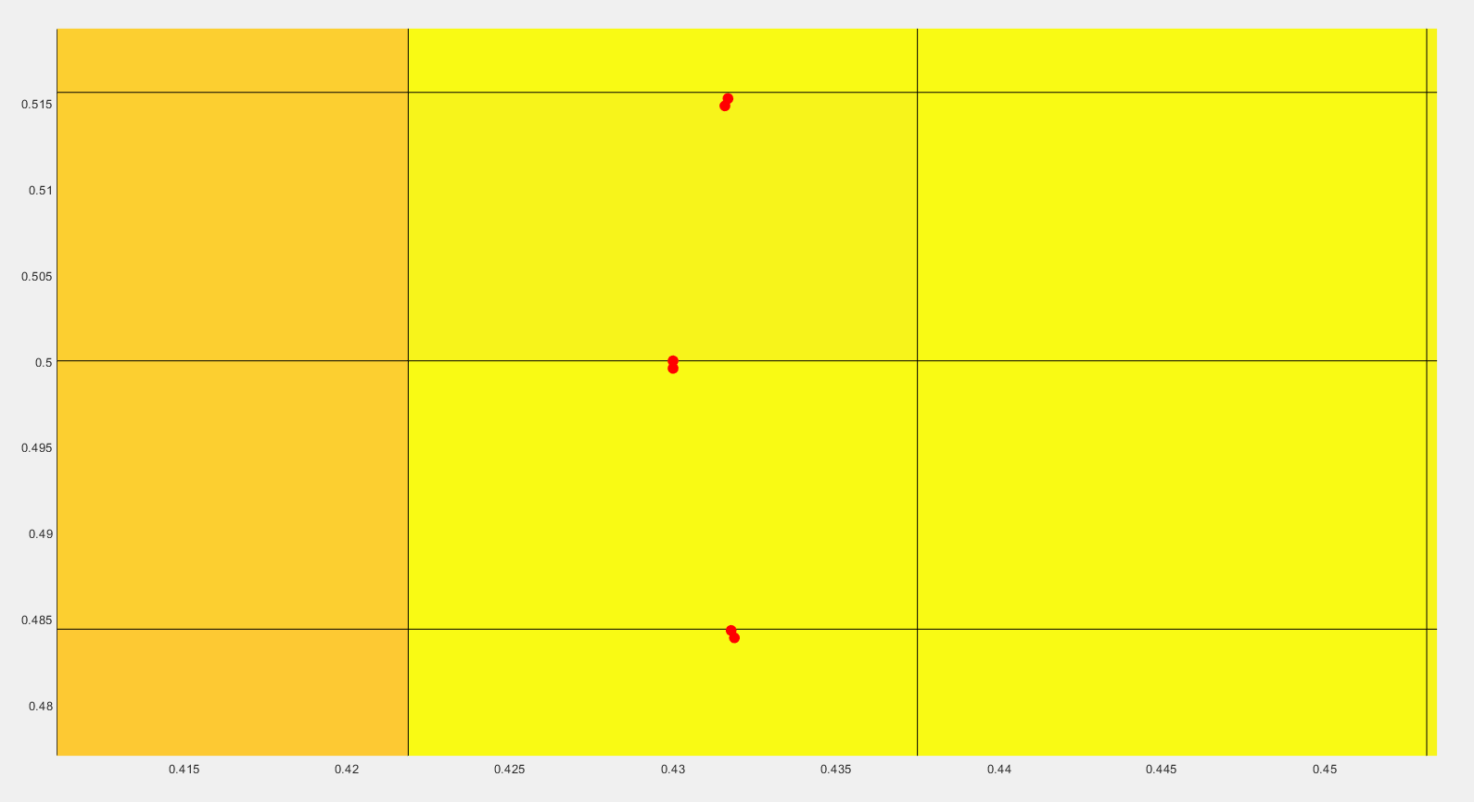
Exemple of Mesh with 2 Points per Cell

Slide 10
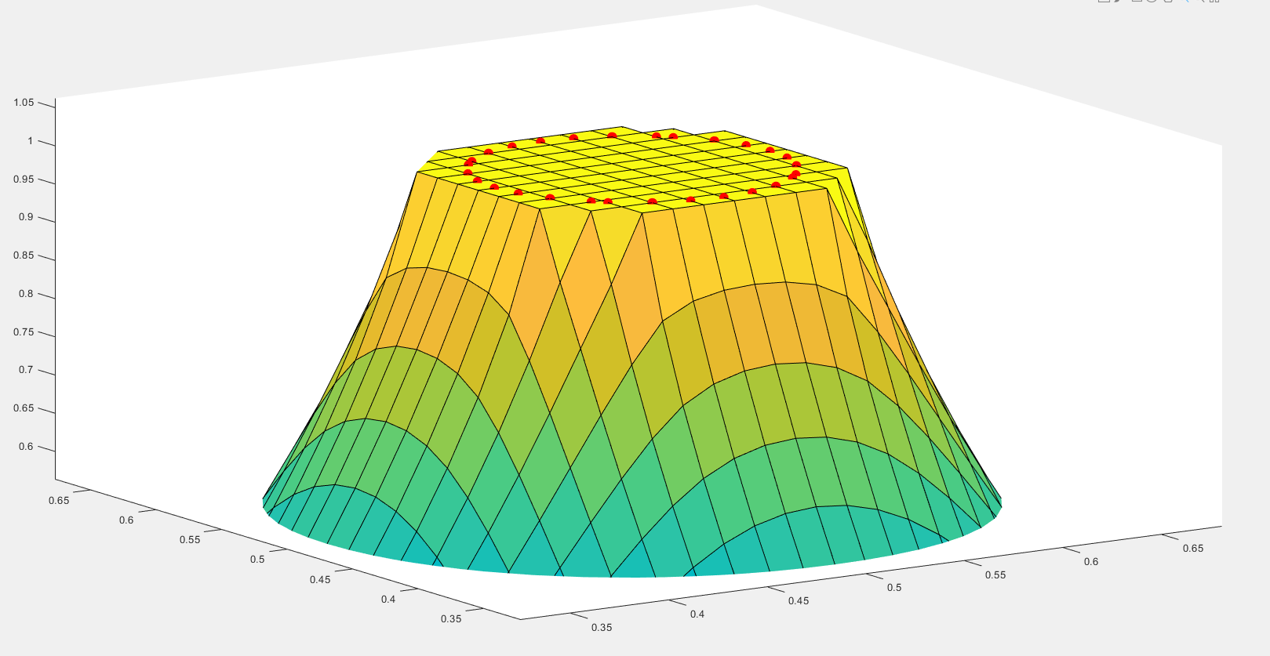
Exemple of Mesh with 2 Points per cell
This method gives the same results as fixing all the cells nodes to the value of the immeresed boundary. So this method should be directly order 1.

Slide 11
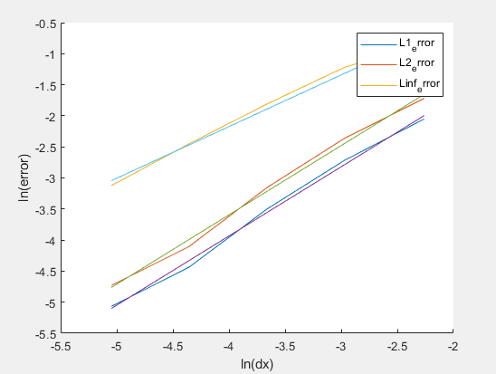
Exemple of Mesh with 2 Points per cell
Convergence plot for 2 points per cell. The solution will converge with a order 1 as expected for the L1 and L2 norm. The order for the L_inf norm is 0.68 . This can be explain by the small number of points on the mesh used.

Slide 12
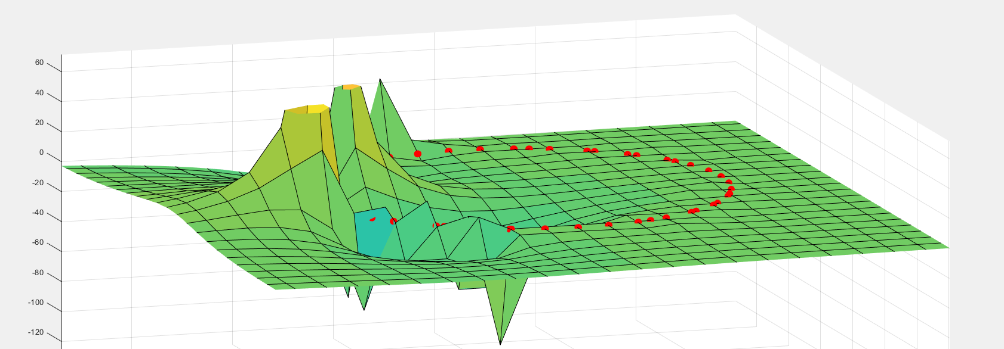
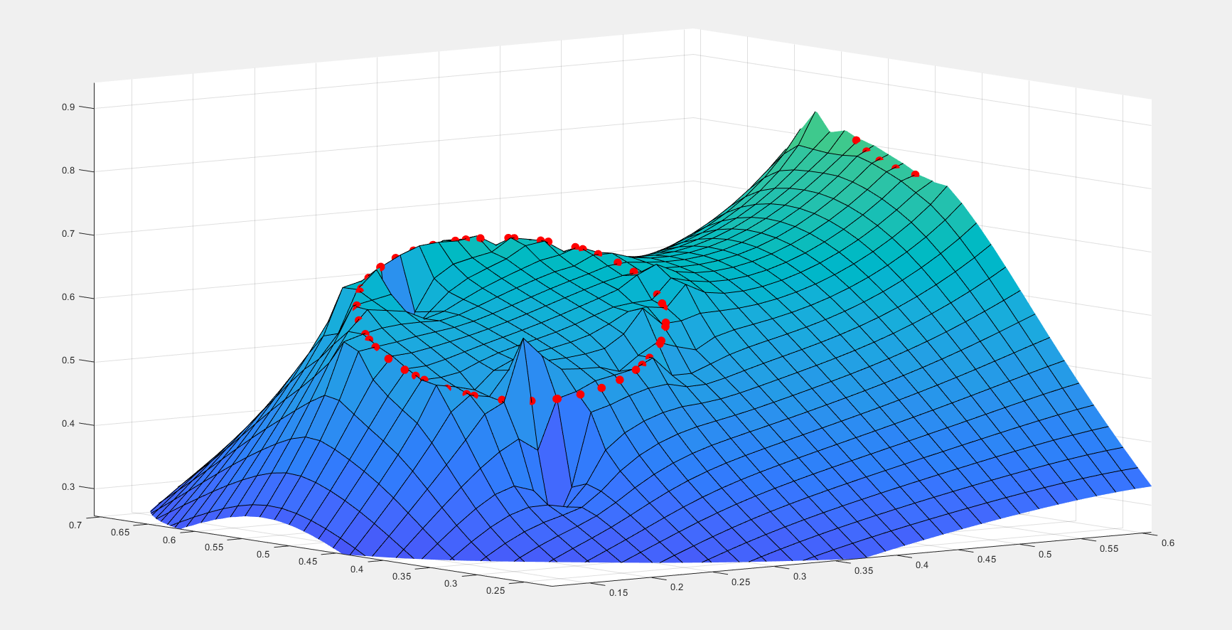
Exemple of Mesh with 2 Points per Cell
Limitation: if the immersed boundary value changes as a function of its position the problems becomes ill defined and oscillations appear.
Solution: Reduce the maximum number of points per cell to 1.
Works but have a lot of oscillation due to under constrained problems.

Slide 13
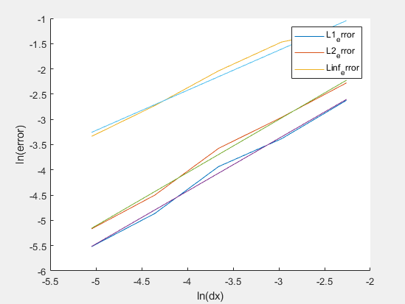
Exemple of Mesh with 1 Points per Cell
The numerical convergence of the error for the solution with 1 point per cell is order 1, but will have an overall lower error compared to the norm of the 2 points per cell.

Slide 14
Imposing Constraint on Edge of Cells.
Consists in finding the intersection of the edge of the subdomain and the edges of the computational domain. Then, Finding the value of the immersed boundary function for those new points and generating a constraint at those new points.
Cell 1
New points created trough interpolation of the sub domain
Cell 2

Slide 15
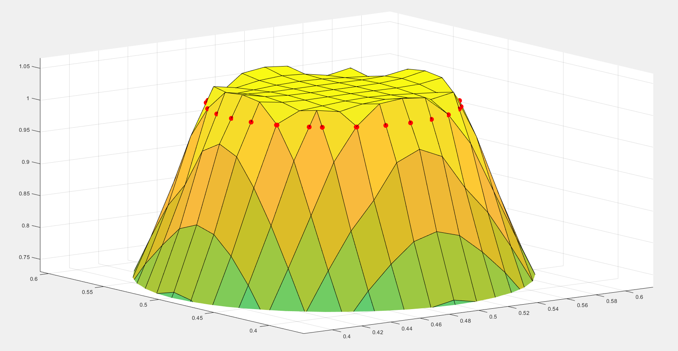
Imposing Constraint on edge of Cells.
This method generally gives a well defined solution near the boundary with small oscillation.

Slide 16
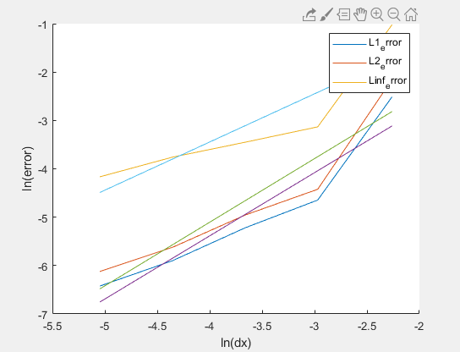
Convergence Using Constraint on the Edge of the Cells.
The solution converges with a high order for the first step in reduction of the mesh size. The convergence then follow a first order convergence for the solution. The overall convergence slope is about 1.3 .
It’s worth noting that the overall error for the refined mesh is smaller with this method of implementation.

Slide 17
Weak Formulation of the Immersed Boundary.
The difference between this formulation and the strong formulation is that in this casethe solution doesn’t have to be equal to the immersed boundary value at the nodes of the immersed boundary mesh or to have a specific value at a specific points. The method we are going to look at is the Integral of the immersed boundary value function in a specific cell evaluated discreetly at the nodes of the subdomain mesh.
Those formulation yield 1 equation per cell that has an immersed boundary inside.

Slide 18

Integral of the Immersed Boundary Function Inside a Cells.
The formulation of this method is given as follows:
  $\int_{δΩ}{U(x)δΓ}=\int_{δΩ}{f(Γ)δΓ}$
  Which means: in a cell the integral of the solution evaluated on the boundary equals the integral in the same cell of the immersed boundary function.
  Once discretized, this is equivalent to saying that the sum of the value of the immersed boundary function nodes inside a cell is equivalent to the sum of the value of the solution evaluated at those same nodes inside a cell.
  $$\sum_{i=1}^{nb}{U\left(x_{i}\right)=\sum_{i=1}^{nb}{f\left(x_{i}\right)}}$$
  $$nb=number of points containt in a cell$$
  $$f=immersed boundary value function$$

Slide 19
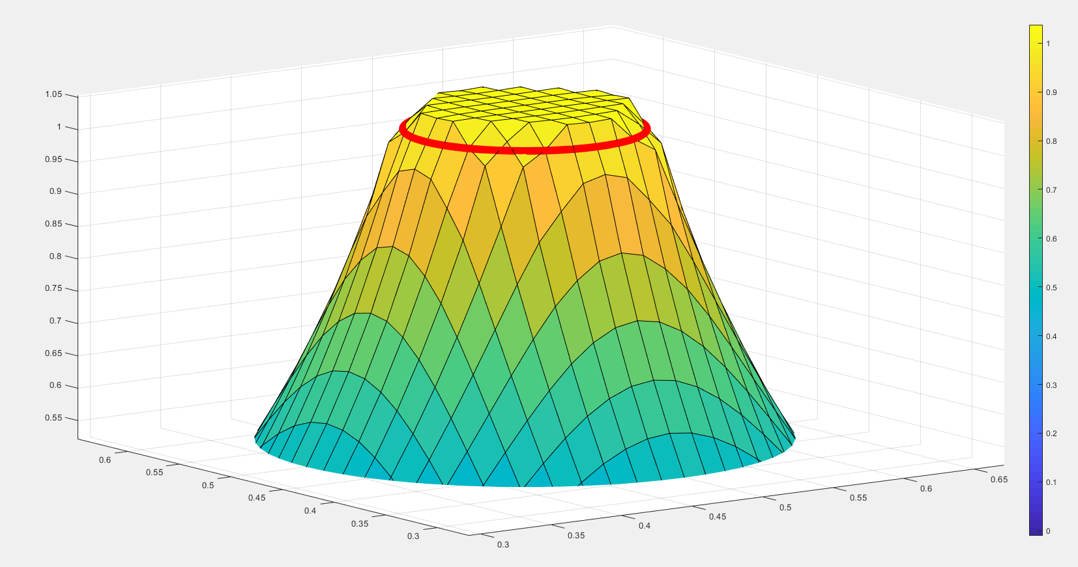
Integral of the Immersed Boundary Function Inside a Cells.
This solution is particularly smooth even though the solution has small oscillations due to the fact that the mesh is not well align with the subdomain mesh.
This methods also create less oscillations on the border of the immersed boundary

Slide 20
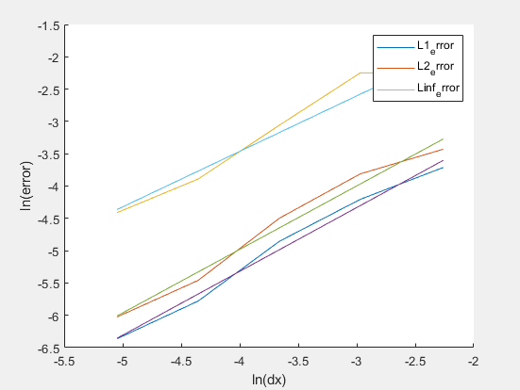
Convergence Using Weak Formulation.
This methods of implementation of the immersed boundary converges with order 1 as well. But the error norm for the smaller mesh is almost the same as for the imposition of the constraint on the edges.

Slide 21

Question ?

Slide 22
References.
Glowinski, R., T.-W. Pan, T.I. Hesla, and D.D. Joseph. 1999. “A Distributed Lagrange Multiplier/fictitious Domain Method for Particulate Flows.” International Journal of Multiphase Flow 25 (5). Pergamon: 755–94.
Boffi, D., L. Gastaldi, L. Heltai, and C.S. Peskin. 2008. “On the Hyper-Elastic Formulation of the Immersed Boundary Method.” Computer Methods in Applied Mechanics and Engineering 197 (25–28).
Heltai, L., and F. Costanzo. 2012. “Variational Implementation of Immersed Finite Element Methods.” Computer Methods in Applied Mechanics and Engineering 229–232.
The deal.II tutorial step-60: Three-field formulation for non-linear solid mechanics, Non-matching grid constraints through distributed Lagrange multipliers, Luca Heltai and Giovanni Alzetta
Oberkampf, W & Roy, Christopher. (2010). Verification and Validation in Scientific Computing. 10.1017/CBO9780511760396.

